Slide 1
City of Aliquippa stormwater fee feasibility and implementation study

Slide 2
Natural vs. Urban Watersheds
• Rain soaks into the ground
• Trees soak up rainwater
• Rain hits rooftops, streets,
and parking lots, but can’t
soak in and creates run off
• Runoff enters storm sewers
1

Slide 3

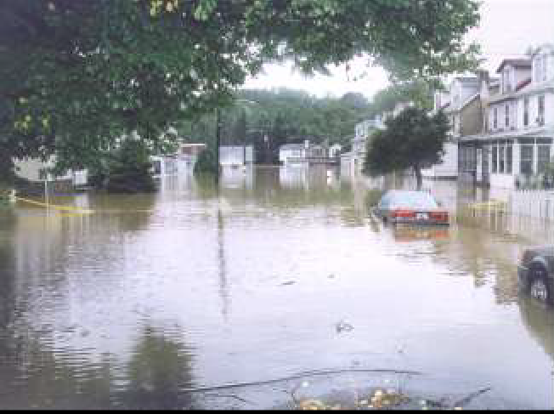

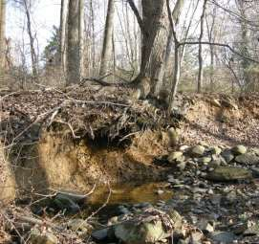

Development Impacts on Water Quantity
Combined Sewer Overflow
Flooding
Erosion
Increased Quantity
Increased Quantity

Slide 4
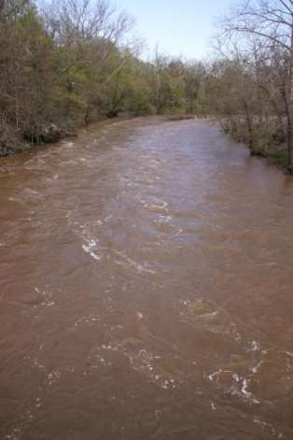




Development Impacts on Water Quality
Decreased quality
Fertilizer Nutrients
Phosphorous
Nitrogen
Sediment
Pathogens
Organic Materials
Toxic Contaminants
Deicing Constituents (salt)
Debris
Thermal Stress
Decreased Quality
Decreased Quality

Slide 5




Municipal Separate Storm Sewer System (MS4) Permit Stormwater Plans Must:
Contain measurable goals for the six Minimum Control Measures (MCMs)
Contain Specific Activities to meet goals for each MCM
Enact or implement either:
An MS4 Stormwater Management Ordinance
An ordinance that satisfies an MS4 Stormwater Management Ordinance Checklist
Submit a Total Maximum Daily Load Plan if applicable
New requirement: submit a Pollutant Reduction Plan for impaired waterways

Slide 6


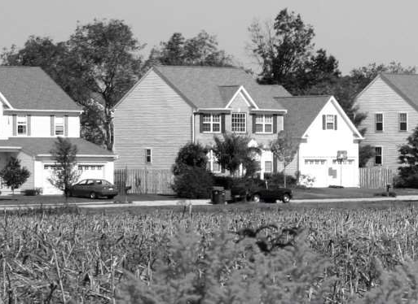
SUMMARY OF STORMWATER MANAGEMENT NEEDS
Stormwater Management
Driven by volume/flooding issues
MS4 Program
Driven by water quality issues
TMDL and pollutant reduction plan requirements

Slide 7
Ways to Fund Stormwater Programs
Multiple Sources
General fund
Bonds
Grants
Loans
Fees
Other
Multiple Budgets
Public Works
Streets
Parks and Recreation
Engineering
Community Development
Planning
Other

Slide 8
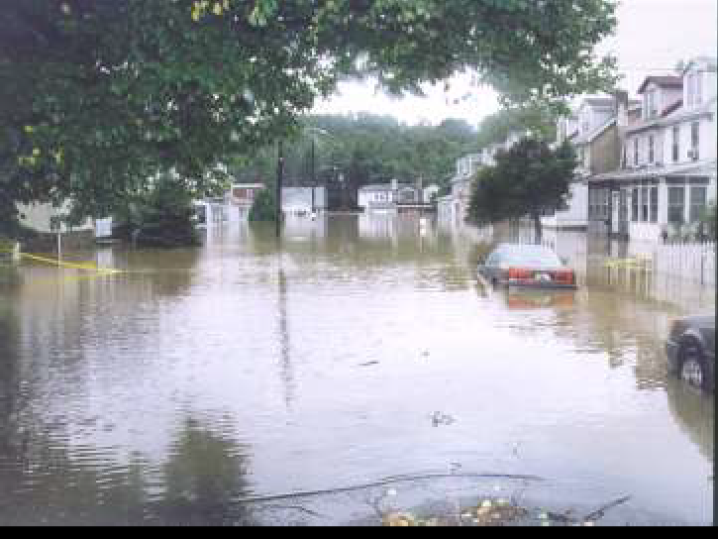
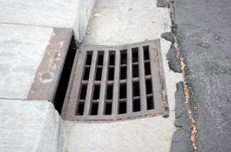
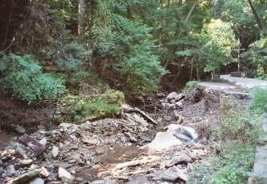
Stormwater Management Needs?
Upgrade and Maintain Infrastructure
Flood Control
Property impacts/ Reduce Erosion

Slide 9
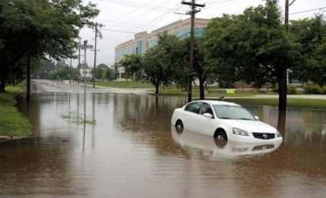
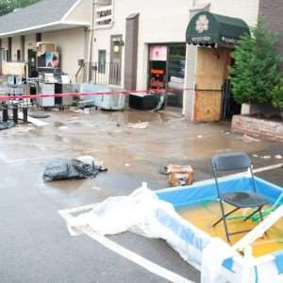
Costs of Inaction
Public Health and Safety Impacts
Increased Flooding
Increased Repair Costs
Increased Water Pollution
Decreased Recreational Opportunities
Potential Lawsuits due to
Increased Flooding
Accelerated deterioration (and repair costs ) of roadways
Regulatory enforcement
8

Slide 10
Potential Sources of Funding?
General fund
Loans
Fees
Bonds
Grants
Other
Eighty seven Pennsylvania Municipalities have Fee Programs
9

Slide 11
Credit Systems and Equity
Base fee for impervious surface typical approach
You pave you pay
Fee system requires credit program
Install green stormwater infrastructure to reduce fee
Consider equity:
1. Variety of housing sizes
2. Small/large lot credit options
3. Low income areas

Slide 12
Implementing an Authority
General Authority
Stormwater Management Act, 32 Pa. Stat. § 680.1
Municipal Planning Code, P.L. 805, No. 247
Create a Utility (an “Authority” in PA)
Municipal Authorities Act 53 Pa. Stat. § 5607, allows for the creation of an authority that performs “storm water planning, management and implementation.”

Slide 13
Implementing a Fee Directly
2016 Legislative Session
HB1325 – Passed! Allows Second Class Township to assess fees for stormwater management activities and facilities. (codified 53 Pa. Stat. § 67705)
2017 Legislative Session
HB913 and 914 – Amending the Borough and Incorporated Town Code to allow assessment of stormwater fees without creating an authority.
HB915 – Amending the 1st Class Township Code to allow assessment of stormwater fees without creating an authority.
HB916 – Amending the City Code to allow assessment of stormwater fees without creating an authority.

Slide 14

Credits
Stormwater Management Practices:
Stormwater BMP Manual
Beyond the BMP Manual
  Lot’s assessed fee
  Percentage of impervious surface from which the first 1.5 inches of stormwater is managed and
  BMP’s Credit Rate (as defined in the ordinance)
Maximum credit of 80% of the fee that would be assessed to that lot in the absence of any credit.

Slide 15
Create a Stormwater Committee
Mayor Dwan Walker
Sam Gill, Business Administrator/CFO
Myron Sainovich, City Solicitor
Janine Malloy, R.A.R. engineering group, inc.
Lawrence Reddick, City Public Works
????????
Develop a stormwater utility budget
Help establish the Stormwater Fee
Facilitate Public Outreach
Review billing procedures
Analyze opportunity for fee credits
Determine process for appeals
14

Slide 16
Stormwater Utility Budget
Review of historical costs on stormwater emergency repairs and system improvements
Allocated wages of Public Works employees who manage the storm water system
Forecast future needs
Consider collection rate and potential credits
15

Slide 17
Stormwater Fee
The fee is based on Equivalent Residential Units (ERUs)
Single Family Detached Homes will be billed a flat rate of $72/year
All other property owners will be billed at the rate of One ERU = 2,200 S.F. of impervious area
One ERU will be billed at a rate of $60/year
1 ERU = 2,200 S.F.
of Impervious Area
Note: Numbers in red to be established
16

Slide 18
Sample Calculation for
Non-Residential Stormwater Fee
Kendrew’s Lounge
Equivalent Commercial Unit ERU = 2,200 SF
Impervious Area of this Property = 38,901 SF
This property would equate to 17.7 ERUs and would be assessed the Stormwater Fee accordingly
Note: Numbers in red to be established
17

Slide 19
Public Outreach
Public meetings were held on xxxxxxxxxxxxxxxxx
City Stakeholders were invited to a Committee meeting by the Mayor which was held on xxxxxxxxxxx
Brochures are available regarding the billing rates and cycles for the Stormwater Fee
The opportunity for credits for property owners who have employed stormwater management practices that reduce negative impacts on the City’s stormwater system are available
There is an appeals process for property owners who would like their impervious area reviewed
Note: Symbols in red to be established
18

